Slide 1
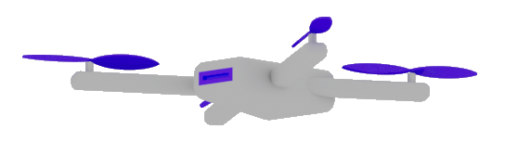
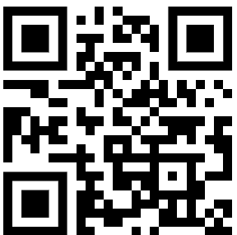
Best practices:
Building Enterprise
Applications
that leverage
GenAI
Dr. Damir Dobric
Lead Software Architect daenet GmbH / ACP Digital
Microsoft Regional Director,
Most Valuable Professional: AI

Slide 2
AGENDA
Embeddings
Vector DBs
RAG
Function Calling
Semantic Kernel
Tools
MCP

Slide 3
DEMO Software v2
Controlling the lighting system
PowerShell in “Klingon” language

Slide 4
EMBEDDINGS AND VECTOR DATABASES

Slide 5
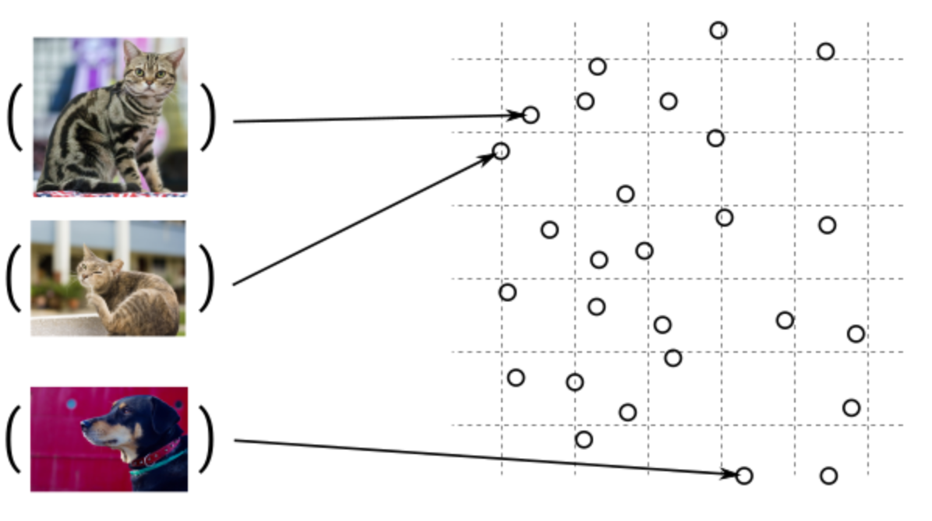
Guess, today is a nice day in Palma
Embedding Models
Today is a typical German rainy day
Two things are infinite: the universe and human stupidity; and I'm not sure about the universe.

Slide 6

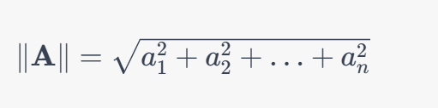
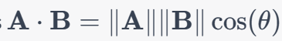
Similarity Between Multidimensional Vectors
Dot Product
The Norm
Cosine Similarity

Slide 7
Vector DBs
SqlServer 2025 Native Vector Search
Quadrant
CosmosDB
…

Slide 8
DEMO
SQL Server Native Vector Search
SQL Server Native Vector
DECLARE @v1 VECTOR(2) = '[1,1]';
DECLARE @v2 VECTOR(2) = '[-1,-1]';
SELECT
VECTOR_DISTANCE('euclidean', @v1, @v2) AS euclidean,
VECTOR_DISTANCE('cosine', @v1, @v2) AS cosine,
VECTOR_DISTANCE('dot', @v1, @v2) AS negative_dot_product;

Slide 9
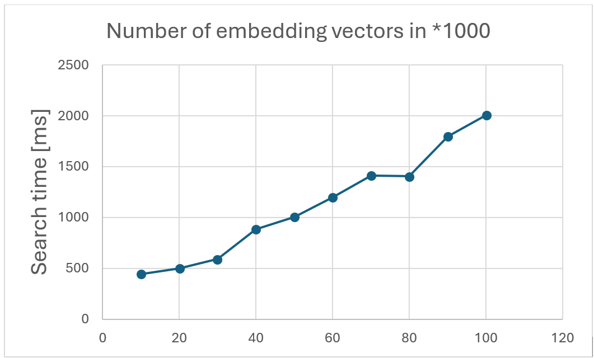
Keep in Mind!!

Slide 10
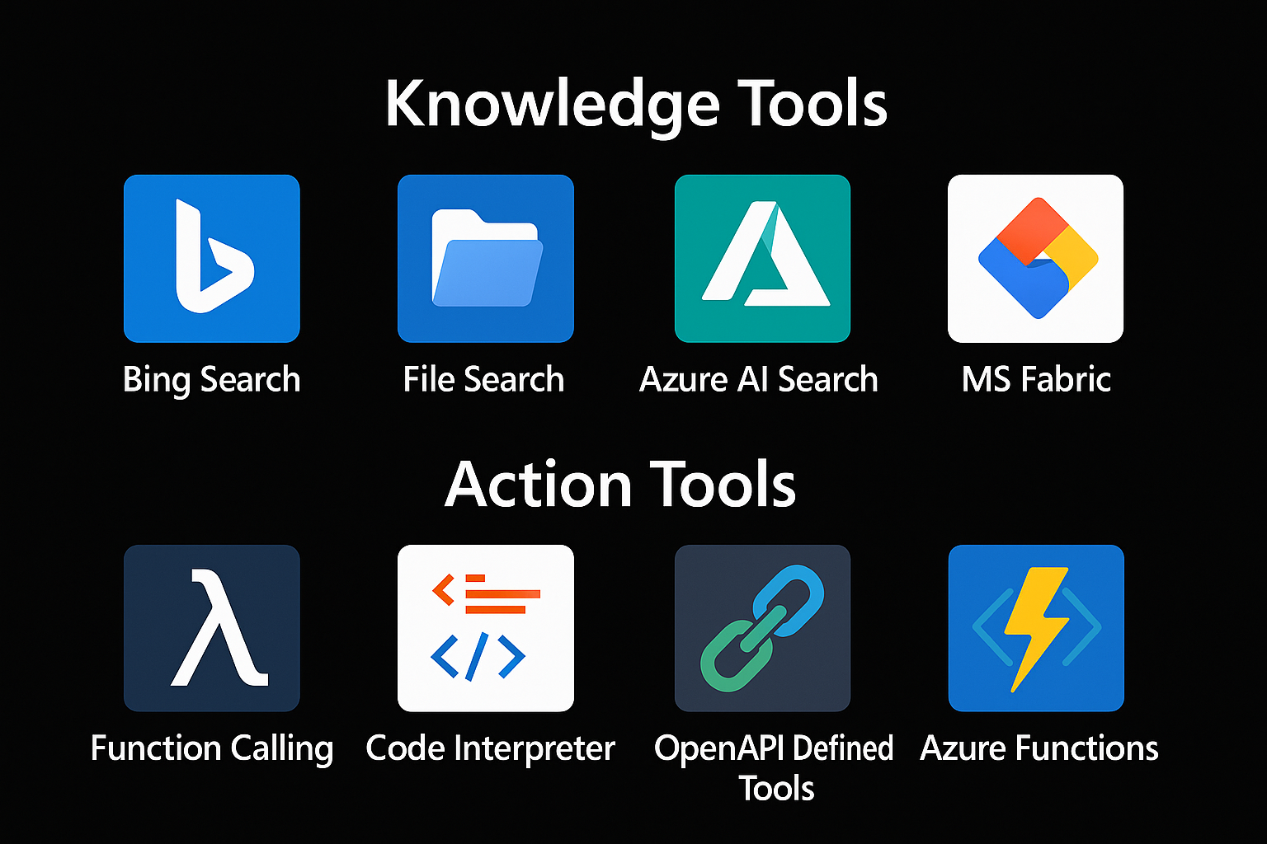

Extending Models with Tools
=> RAG
Tool 1
AGENT
=> Function Calling
Tool 2

Slide 11
RAG Retrieval Augmented Generation

Slide 12
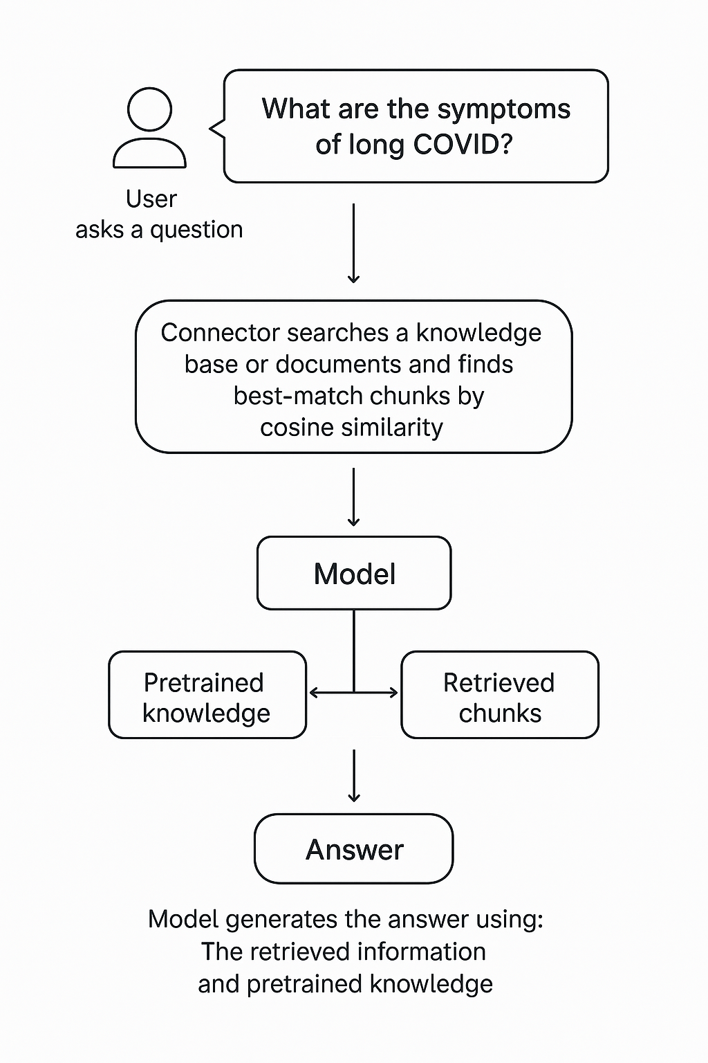
RAG Retrieval-Augmented Generation
Extending the model knowledge
Combines information retrieval with text generation
https://arxiv.org/abs/2005.11401

Slide 13
DEMO (c#)
Creating chunks
Creating embeddings
InMemory Vector DB
Calculating Similarity

Slide 14
Function Calling

Slide 15



Chat Model Interaction
User: How are you?
(1)
AI
Prompt
(2)
Agent: I‘m fine, how can I help you

Slide 16
Function Calling
{
"type": "function",
"function": {
"name": "get_weather",
"description": "Retrieves current weather for the given location.",
"strict": true,
"parameters": {
"type": "object",
"properties": {
"location": {
"type": "string",
"description": "City and country e.g. Bogotá, Colombia"
},
"units": {
"type": ["string", "null"],
"enum": ["celsius", "fahrenheit"],
"description": "Units the temperature will be returned in."
}
},
"required": ["location", "units"],
"additionalProperties": false
}
}
}

Slide 17

Function Calling
User: Switch on the light to green.
LichtPlugin
SwitchLightOn(color)
SwitychLightOff
(1)
WeatherPlugin
ShowInfo(Location)
AI
Prompt
(2)
My Database
Tool: SwitchLightOn(green)
Schritt 2:
KI ermittelt aus dem Prompt die passende Funktion und Argumente. Bsp.:
SchallteLichAn(grün)
Plugin Library
Enthält die Beschreibungen von Funktionen.

Slide 18
Function Calling
User: Set the light on green?
(1)
(1)
Service
KI
PlugInLIbrary
(2)
(5)
Prompt
(3)
(4)
Licht Connector (API)
Tool: SetLight(green)
Schritt 2:
KI ermittelt aus dem Prompt die passende Funktion und Argumente. Bsp.:
SchallteLichAn(grün)
Plugin Library
Enthält die Beschreibungen von Funktionen.

Slide 19
DEMO (c#)
Function Calling with
SemanticKernel Plugin

Slide 20
Completions Chat Streaming TextToSpeech Look into the image Image Generation Image Edit Embeddings RunRetrievalAugmentedGenerationAsync();
OpenAI SDK

